Slide 1
Database Systems
Lecture 24
Normalization

Slide 2
Today’s Agenda
Second Normal Form
Third Normal Form

Slide 3
Second Normal Form (1)
Uses the concepts of FDs, primary key
Definitions:
Prime attribute - attribute that is member of the primary key K
Full functional dependency - a FD Y -> Z where removal of any attribute from Y means the FD does not hold any more
Examples: - {SSN, PNUMBER} -> HOURS is a full FD since neither SSN -> HOURS nor PNUMBER -> HOURS hold
- {SSN, PNUMBER} -> ENAME is not a full FD (it is called a partial dependency ) since SSN -> ENAME also holds

Slide 4
Second Normal Form (2)
A relation schema R is in second normal form (2NF) if every non-prime attribute A in R is fully functionally dependent on the primary key
R can be decomposed into 2NF relations via the process of 2NF normalization

Slide 5
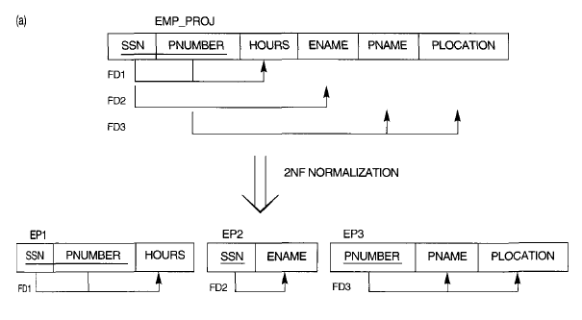
Normalizing into 2NF and 3NF. (a) Normalizing EMP_PROJ into 2NF relations

Slide 6
Third Normal Form (1)
Definition:
Transitive functional dependency - a FD X -> Z that can be derived from two FDs X -> Y and Y -> Z
Examples:
- SSN -> DMGRSSN is a transitive FD since
SSN -> DNUMBER and DNUMBER -> DMGRSSN hold
- SSN -> ENAME is non-transitive since there is no set of attributes X where SSN -> X and X -> ENAME

Slide 7
Third Normal Form (2)
A relation schema R is in third normal form (3NF) if it is in 2NF and no non-prime attribute A in R is transitively dependent on the primary key
R can be decomposed into 3NF relations via the process of 3NF normalization
NOTE:
In X -> Y and Y -> Z, with X as the primary key, we consider this a problem only if Y is not a candidate key. When Y is a candidate key, there is no problem with the transitive dependency .
E.g., Consider EMP (SSN, Emp#, Salary ).
Here, SSN -> Emp# -> Salary and Emp# is a candidate key.

Slide 8
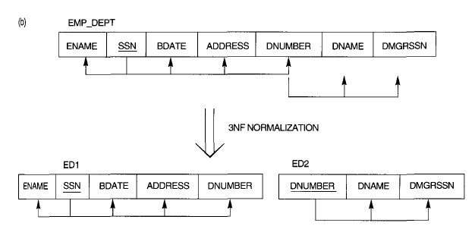
Normalizing into 2NF and 3NF. (b) Normalizing EMP_DEPT into 3NF relations.

Slide 9
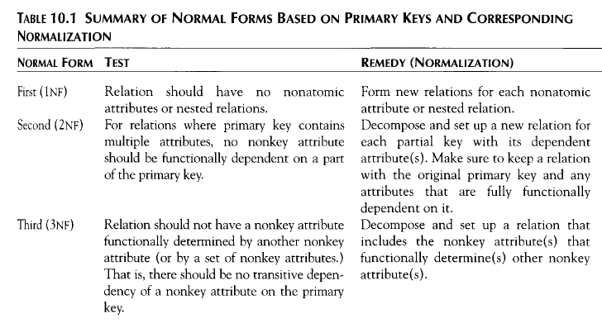

Slide 10
General Normal Form Definitions (For Multiple Keys)
The above definitions consider the primary key only
The following more general definitions take into account relations with multiple candidate keys

Slide 11
General Definition of Second Normal Form
A relation schema R is in second normal form (2NF) if every nonprime attribute A in R is not partially dependent on any key of R.

Slide 12
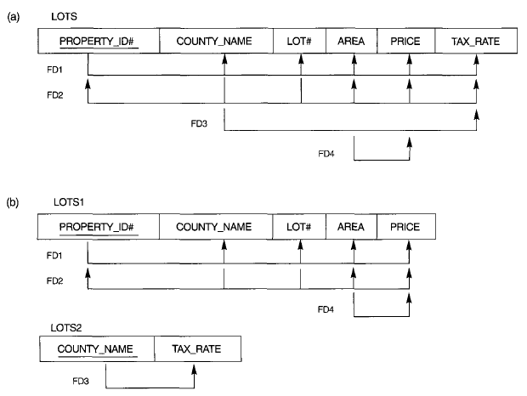
Normalization into 2NF (a) the LOTS relation with its functional dependencies FD1 though FD4. (b) Decomposing into the 2NF relations LOTS1 and LOTS2.

Slide 13
General Definition of Third Normal Form
Definition:
Superkey of relation schema R - a set of attributes S of R that contains a key of R
A relation schema R is in third normal form (3NF) if whenever a FD X -> A holds in R, then either:
(a) X is a superkey of R, or
(b) A is a prime attribute of R
NOTE: Boyce-Codd normal form disallows condition (b) above

Slide 15
Normalization into 3NF. (c) Decomposing LOTS1 into the 3NF relations LOTS1A and LOTS1B. (d) Summary of the progressive normalization of LOTS.

Slide 16
BCNF (Boyce-Codd Normal Form)
A relation schema R is in Boyce-Codd Normal Form (BCNF) if whenever a FD X -> A holds in R, then X is a superkey of R
Each normal form is strictly stronger than the previous one
Every 2NF relation is in 1NF
Every 3NF relation is in 2NF
Every BCNF relation is in 3NF
There exist relations that are in 3NF but not in BCNF
The goal is to have each relation in BCNF (or 3NF)

Slide 17
Summary of Normal forms
X -> A
In this case, If X is prime and A is non prime, then it is not in 2nd normal form.
X -> A
In this case, If X is non prime and A is also non prime, then it is not in 3rd normal form.
X -> A
In this case, If X is prime/ non prime and A is prime, then it is in BCNF.

Slide 18
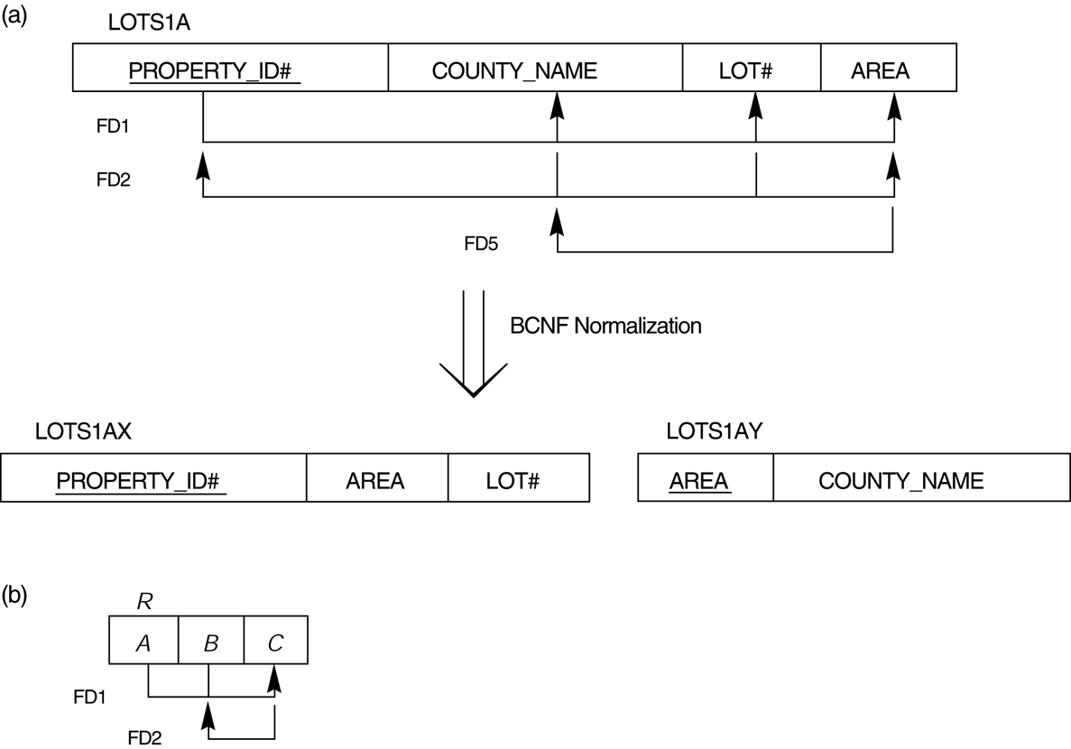
FIGURE 10.12 Boyce-Codd normal form. (a) BCNF normalization of LOTS1A with the functional dependency FD2 being lost in the decomposition. (b) A schematic relation with FDs; it is in 3NF, but not in BCNF.

Slide 19
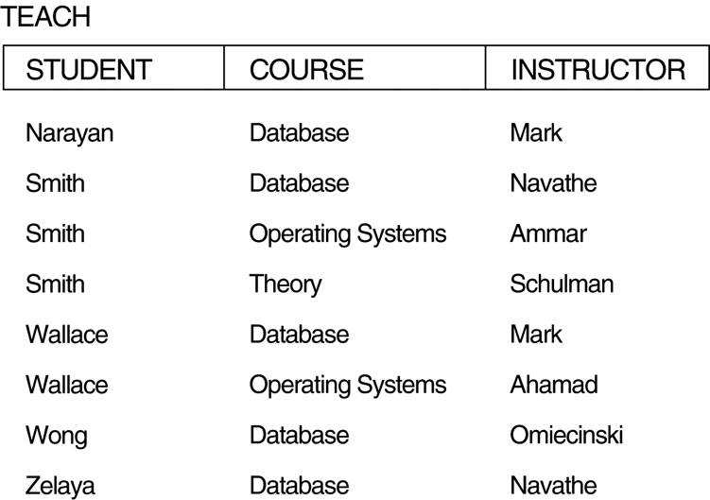
FIGURE 10.13 A relation TEACH that is in 3NF but not BCNF.

Slide 20
Achieving the BCNF by Decomposition (1)
Two FDs exist in the relation TEACH:
fd1: { student, course} -> instructor
fd2: instructor -> course
{student, course} is a candidate key for this relation and that the dependencies shown follow the pattern in Figure 10.12 (b). So this relation is in 3NF but not in BCNF
A relation NOT in BCNF should be decomposed so as to meet this property, while possibly forgoing/sacrificing the preservation of all functional dependencies in the decomposed relations.

Slide 21
Achieving the BCNF by Decomposition (2)
Three possible decompositions for relation TEACH
{student, instructor} and {student, course}
{course, instructor } and {course, student}
{instructor, course } and {instructor, student}
All three decompositions will lose fd1. We have to settle for sacrificing the functional dependency preservation. But we cannot sacrifice the non-additivity property after decomposition.
Out of the above three, only the 3rd decomposition will not generate spurious tuples after join.(and hence has the non-additivity property).
A test to determine whether a binary decomposition (decomposition into two relations) is nonadditive (lossless) is discussed in section 11.1.4 under Property LJ1. Verify that the third decomposition above meets the property.

Slide 22
Normal form identification
R (ABCDEFGH) and if AB is the key
AB->C (BCNF)
A->DE (1NF)
B->F (1NF)
F->GH (2NF)

Slide 23
Normal form identification
R (ABCDE) and if CE is the key
CE->D (BCNF)
D->B (2NF)
C->A (1NF)

Slide 24
Normal form identification
R (ABCDEF) and if ABD and BCD is the key
AB->C (3NF)
DC->AE (1NF)
E->F (2NF)

Slide 25
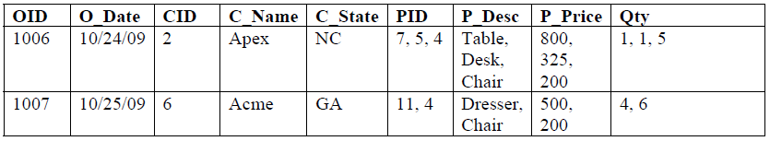

Normalize the following table upto 3NF

Slide 26
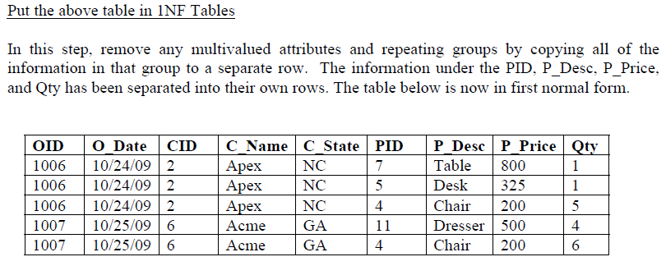

Slide 27
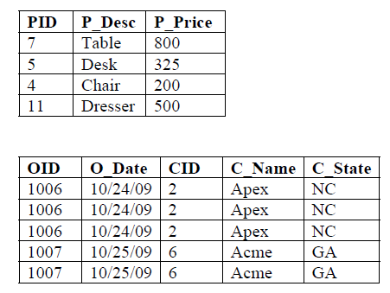
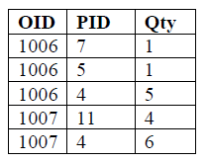

Slide 28
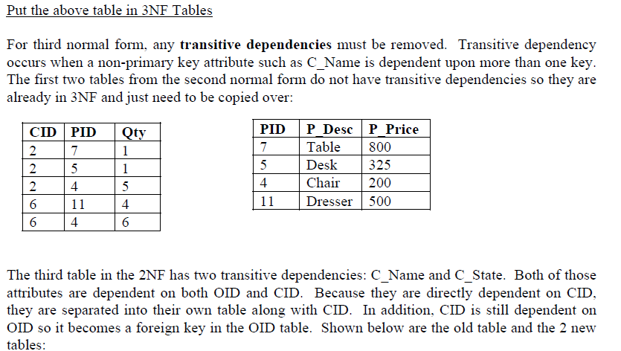

Slide 29
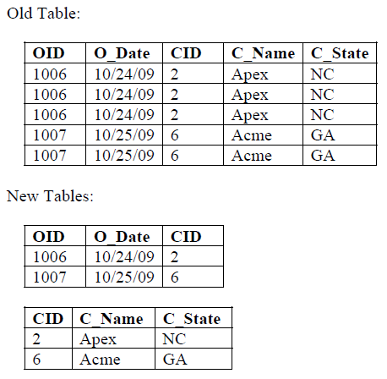

Slide 30
